Slide 1
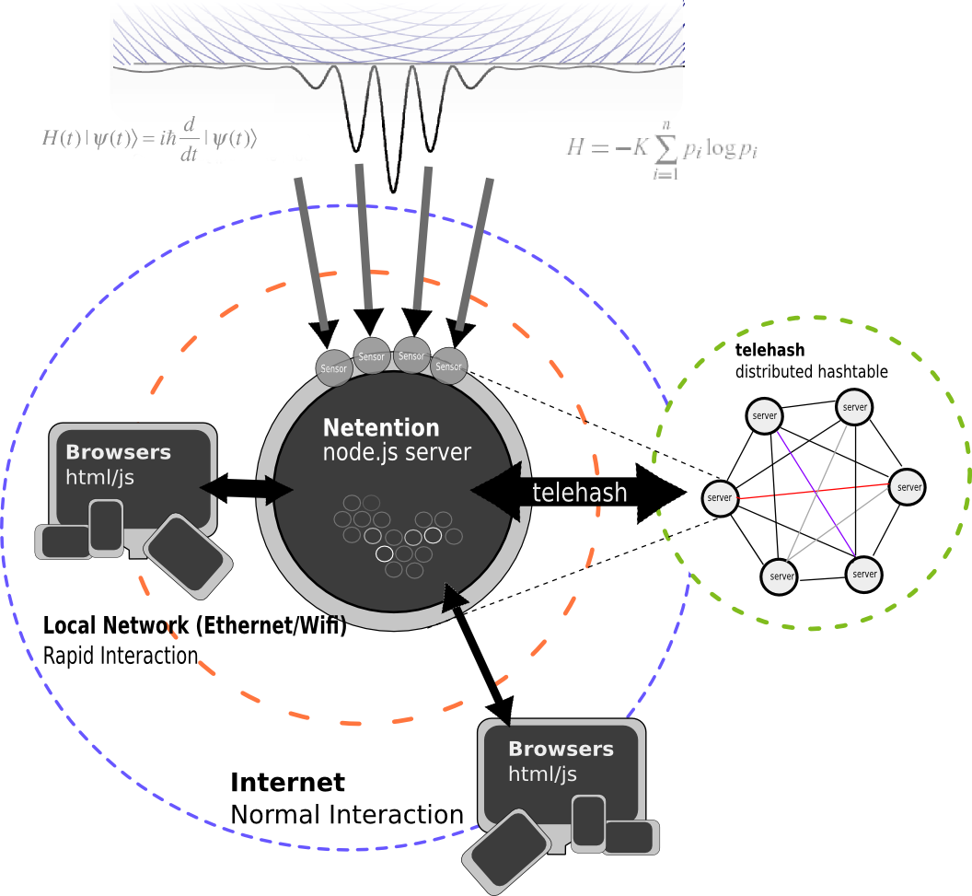

Slide 2
when complete, this may implement a mailpool across both short-term and long-term communications.
the attention and data records collected can be machine learned to fine tune the matching but providing an optional controlled ontology in the UI does reduce the problem space.
See: www.mattmahoney.net/agi2.html

Slide 3
it should get more clear as it becomes more developed but the less descriptions necessary to label things in the system, the more free it can become. it's meant to do a lot so there should be even less of a description necessary.
if the UI is entirely intuitive, made as simple as possible, it will resemble the basic mailpool interface of an input area with output area.

Slide 4
real-time group attention can be recorded and analyzed

Slide 5
using node.js and socket.io (compiled with "blazing fast native extensions") provides websockets communication for realtime async client->server communication

Slide 6
telehash allows servers to share data in a DHT using an algorithm common and compatible with bittorrent.

Slide 7
sensors feed data asynchronously into the object engine which can be broadcast to clients with relevant subscribed interests. socket.io provides channeled pub/sub.

Slide 8
upon receiving data, a client can display it on a map, a time line, a list or table, and edited into more complex semantic objects such as personally relevant statements, intentions, projects, investments, advertisements, etc..
...through the application of a combination of types (ontology classes) and their associated property values

